Slide 1
Infinite Loyola Stairs - progress report -
Affiliation: Department of Korean Language & Literature, Sogang University
Student ID: 20220042
Name: Hyeonseo Kim (김현서)

Slide 2
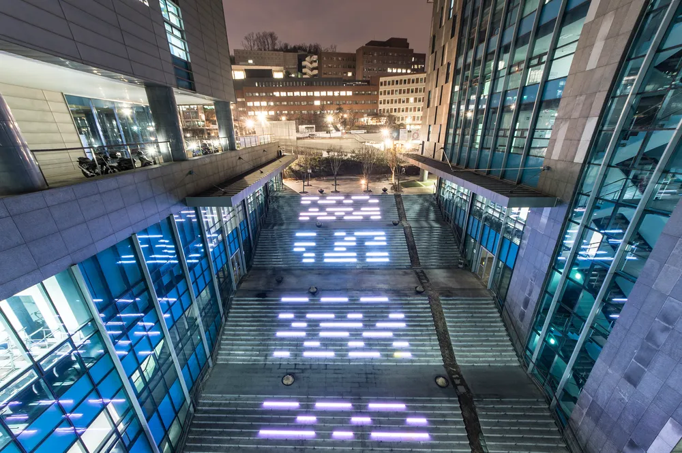
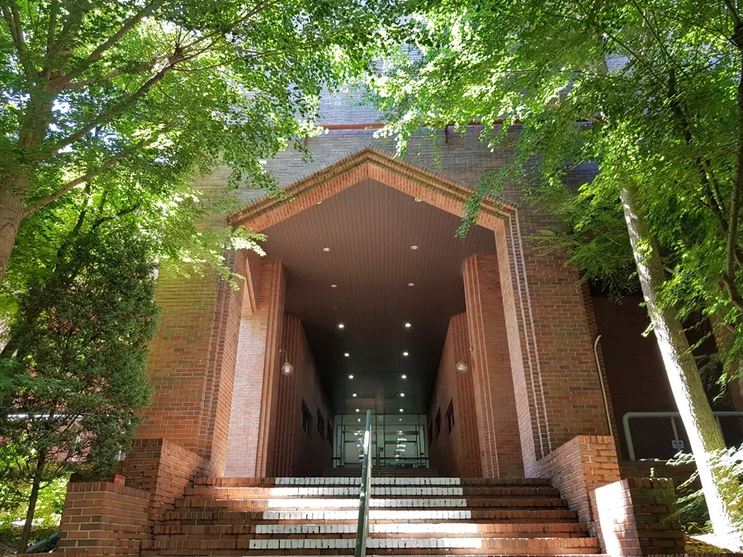


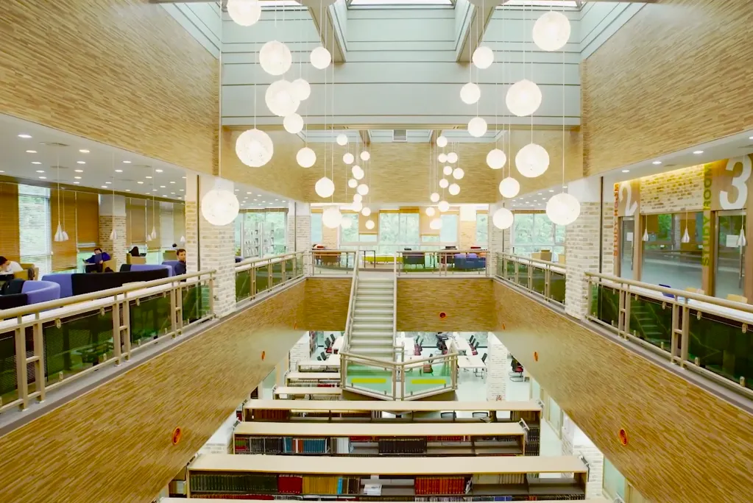

PLAN
* MAIN CHARACTER: Alros | * BACKGROUND (J-TE) | * BACKGROUND (D)
 | * BACKGROUND (Manresa) | * STYLE: Pixel Art

Slide 3















DESIGN (1) MAIN CHARACTER

Slide 4
DESIGN (2) STAIRS

Slide 5
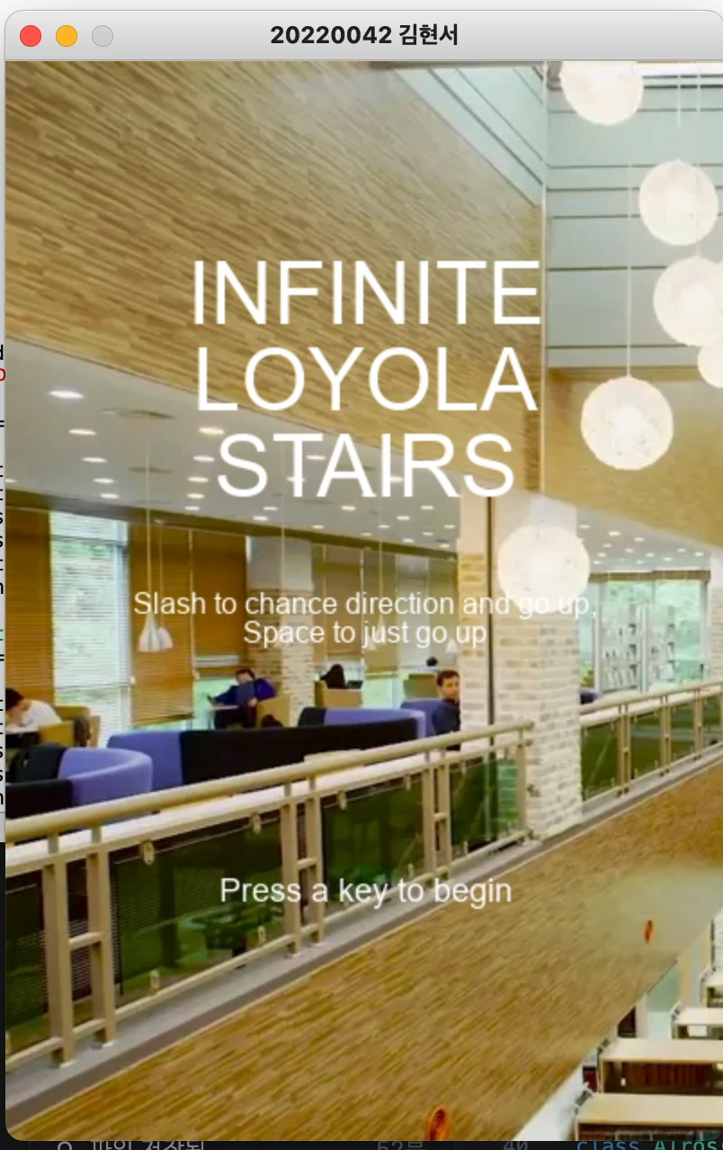
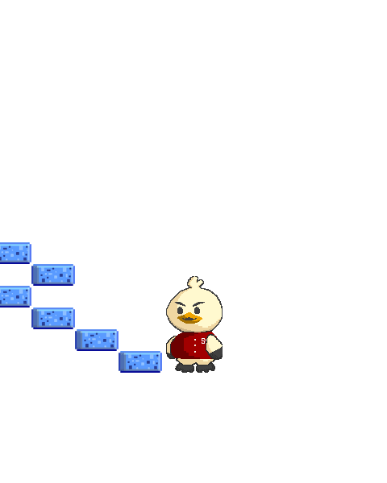
FLOW
I want moving like this but yet…

Slide 6
PLAN - Code
Code
- modify Stair class
- modify Alros class
=> solve movement problem
- add HP bar (wear rate: faster and faster)

Slide 7
PLAN – Sound, Design
Background sound
Key pressed -> sound
Game over -> sound
+@: Background image drawing(very big Canvas)

Slide 8
THANK YOU

